Slide 1
XSS and CSRF
Stop Exploitation Through Prevention
Michaela Sallese

Slide 2
XSS
Cross-Site Scripting
Windows 1999
JavaScript and DOM manipulation
See an Input Field, Execute the Code
Reflected vs Stored/Persistent Attacks
Notes:
In my research, I thought how would this affect a user that doesn’t know the difference between this and a virus-- it looked easily mistakable to a virus for a novice computer user.

Slide 3
Preventing XSS Attacks
JavaScript event handlers & HTML
&lt;
DOMPurify
htmlentities
Browser does not know better.

Slide 4
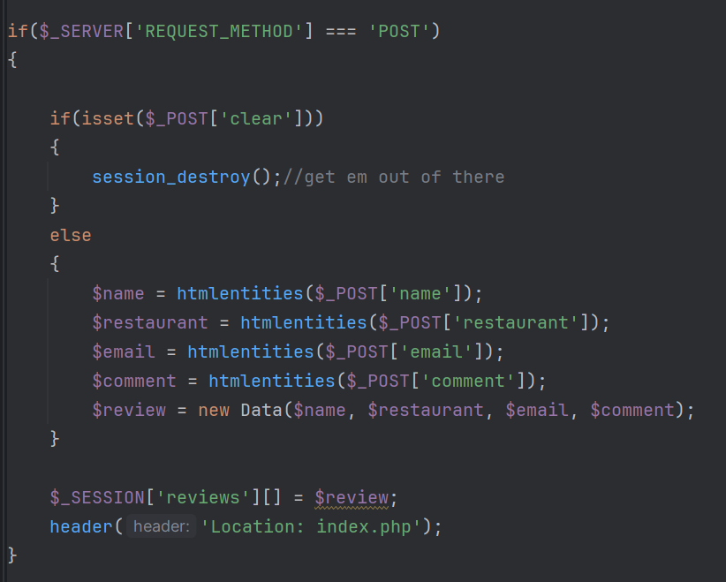
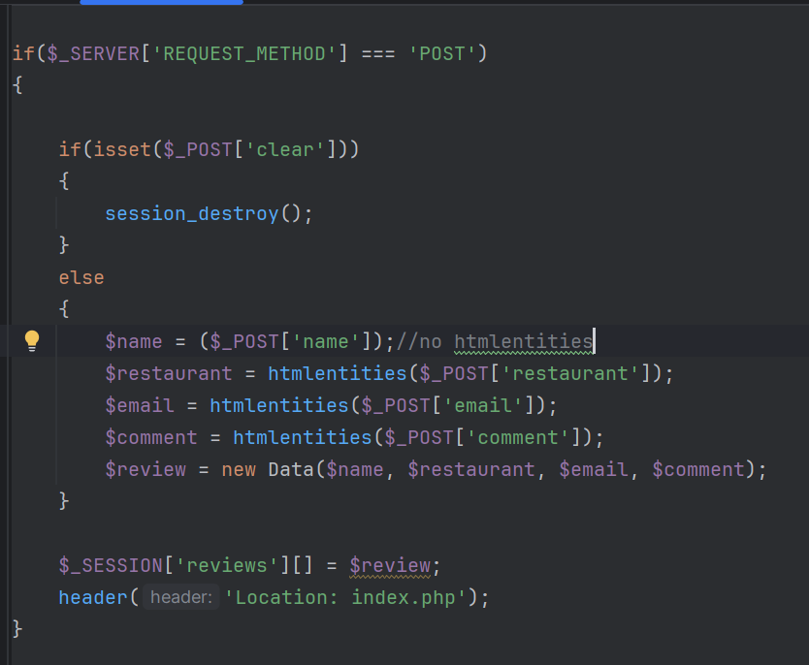

Slide 5
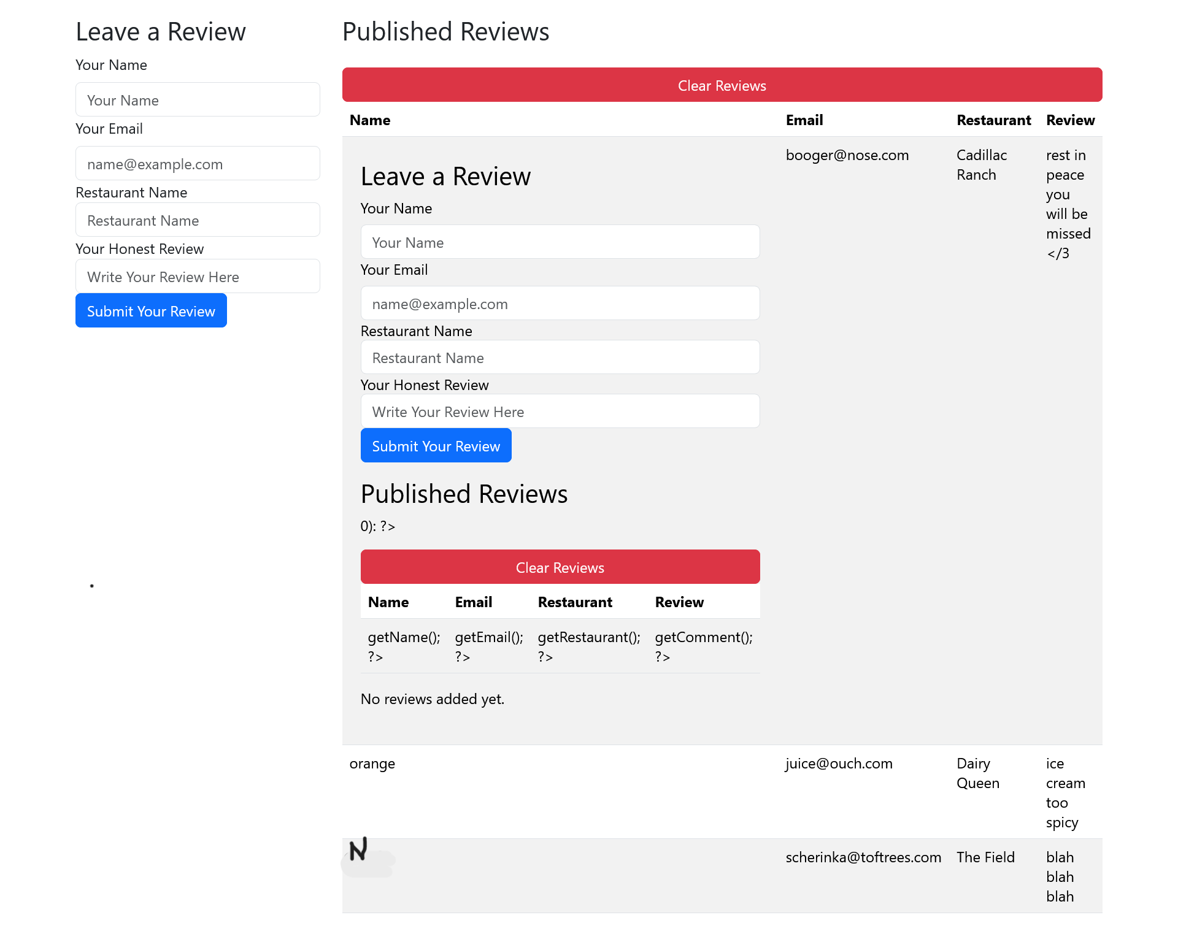
Notes:
Much messier page after trying to insert a funny video-- shows backend!

Slide 6
CSRF
Cross-Site Request Forgery
Peter Watkins 2001
Copy of a Trusted Site
Fool one person onc
Hidden Input Fields
JavaScript onChange to send whatever is typed in to someone else

Slide 7
Protect from CSRF
Data being sent in Get and Post requests
Tokens
String of characters that must match
KVP
Same Origin Policy
AJAX Requests
Cookies
Notes:
Kvp-- key value pair-- if this part of the JSON object matches, do the thing.

Slide 8
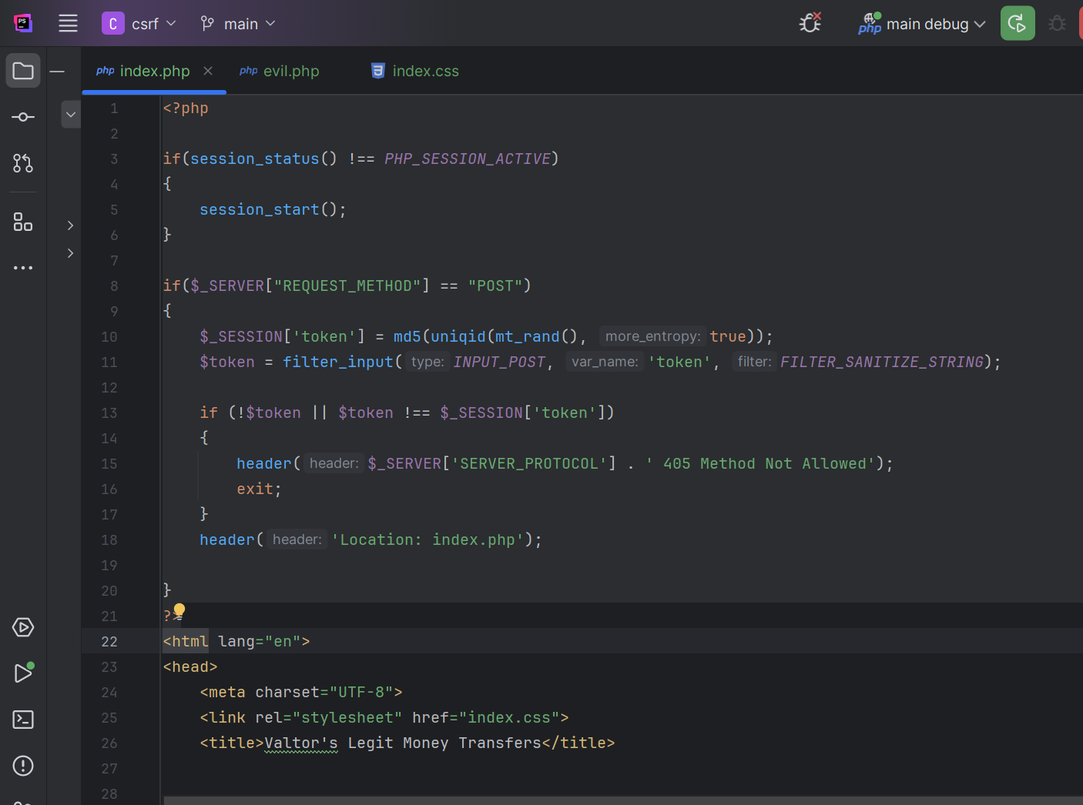
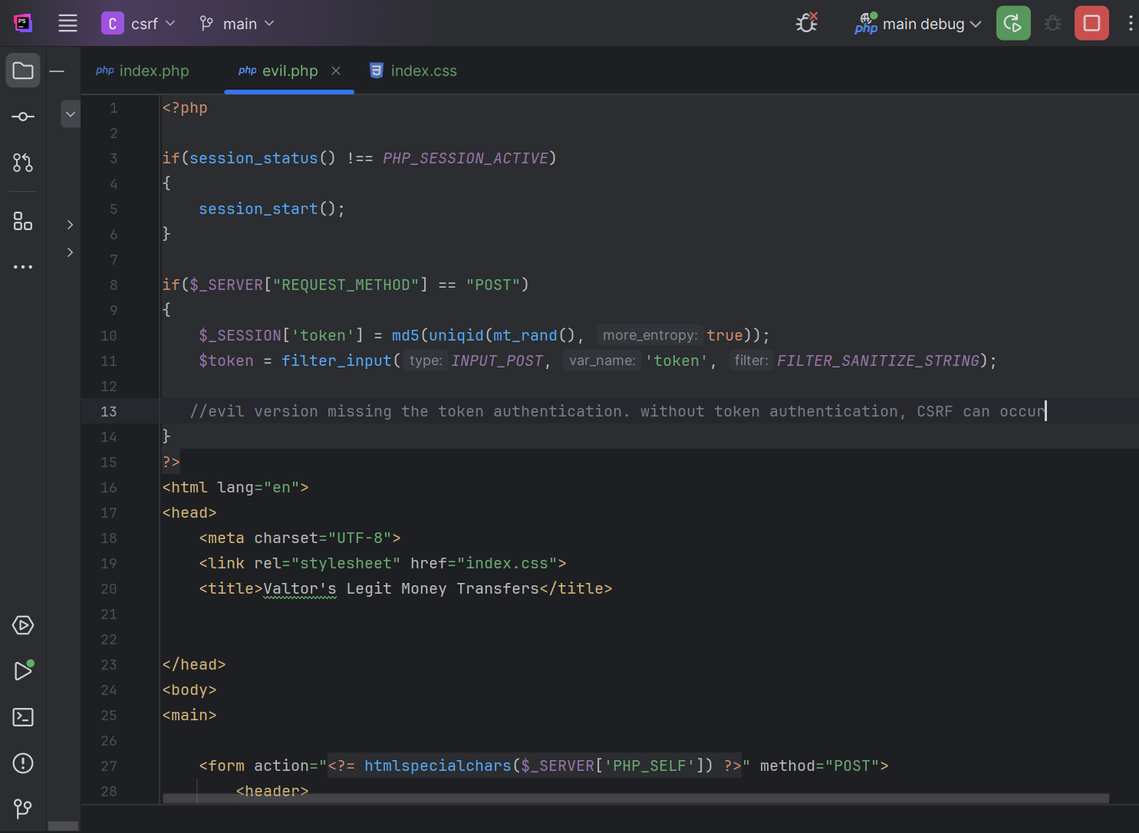
Notes:
Code on the left has token authentication-- if the token does not match, send 405 not allowed. Just these 3 lines of code make the difference between allowing a malicious action.

Slide 9
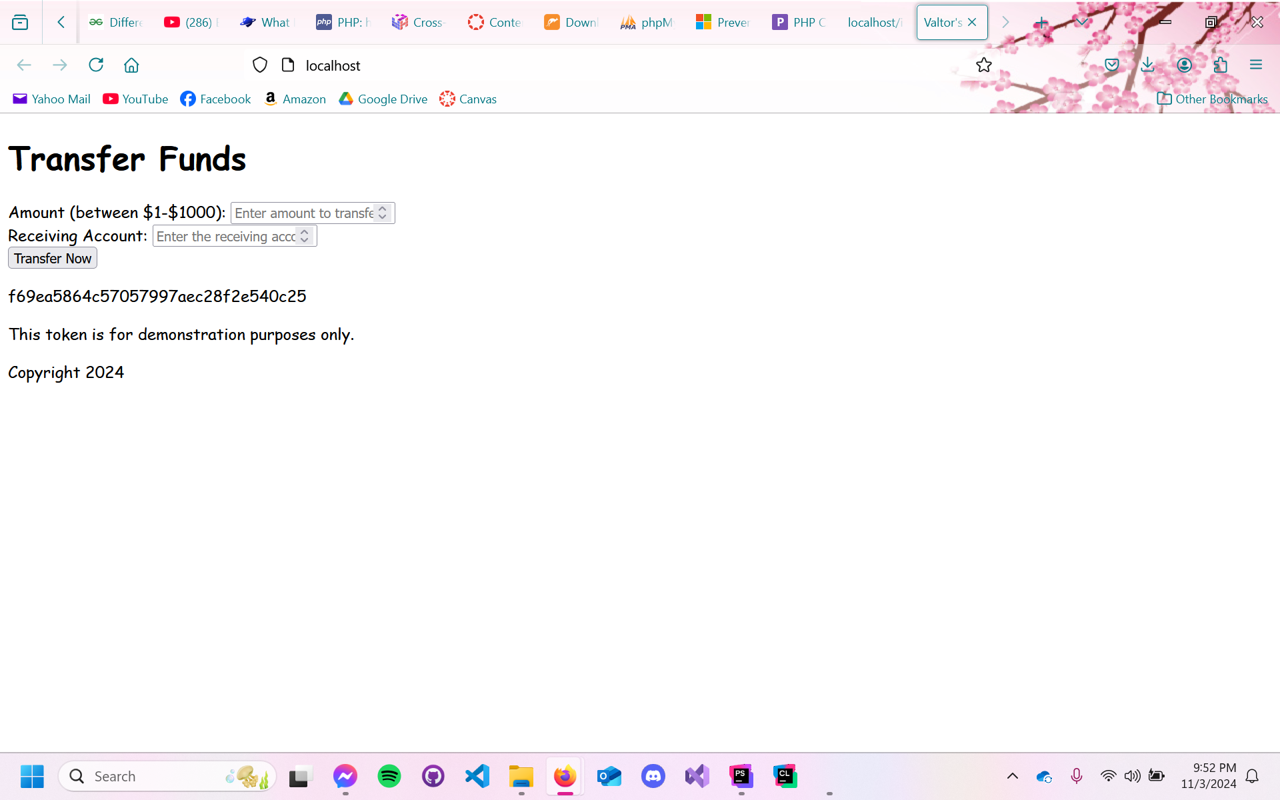
Notes:
A bank transfer page with the generated token displayed. This token changes every time a new session of this transfer is deployed.

Slide 10
XSS and CSRF
Many different users on the web
Don’t put too much work on user to protect themselves
Our primary job is to make safe applications
Be the hero you want to see
Bug Bounties
Don’t try to break it, try to fix it.

Slide 11
THANK YOU

